Slide 1

Data Transformation I

Slide 2
Data Transformation I Info
Read Chapter 3
Goal: Getting Data the In the Way You Want
Covers:
Data Subsetting
Data Ordering
Variable Selecting
Variable Creating
Help: dplyr Package in R

Slide 3
NYC Flights Meta Data
Requirements:
All 2013 Flights from NYC
- US Bureau of Trans. Statistics
To View all Data, Use
For more information,
> install.packages(nycflights13)
> library(nycflights13)
> View(flights)
> ?flights

Slide 4
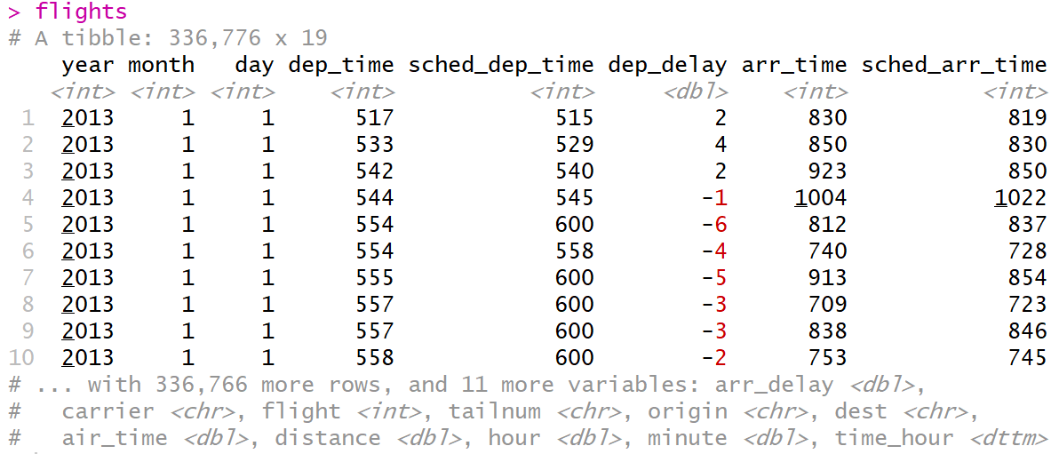
NYC Flights Meta Data
Preview Data:
Four Different Types of Variables
int = integer
dbl = double
chr = character
dttm = date and times
Other Types of Variables
lgl = logical (TRUE or FALSE)
fctr = factor
date = dates
> flights

Slide 5
Basics of dplyr
5 Key Functions
filter() = Chooses Observations Based on Values
arrange() = Sorts Observations
select() = Chooses Variables
mutate() = Creates New Variables
summarize() = Generates Statistics From Data

Slide 6
Basics of dplyr
Function Usage
First Specify Data
Next Specify What to Do with the Data
Result is New Data
Powerful When Used With group_by() Function

Slide 7
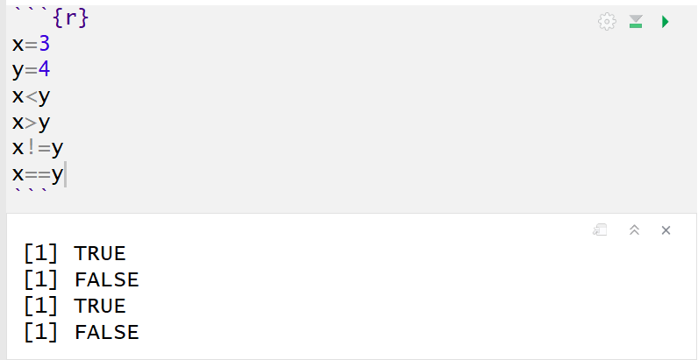
Comparisons
Important Operators
Less Than (<)
Greater Than (>)
Not Equal (!=)
Equal (==)
Returns TRUE or FALSE

Slide 8
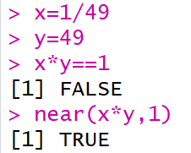
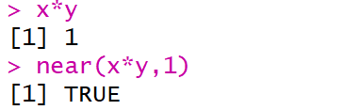
Comparisons
Numerical Precision
Problem
Solution

Slide 9
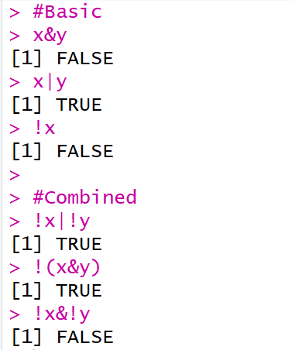
Logical Operators
Boolean Logic
And (&)
Or (|)
Not (!)
Example

Slide 10
Missing Values
Represented by NA
Enduring Questions
To Impute or Not Impute
To Ignore or Not Ignore
Handling Should Be Explained
Be Careful When Performing Operations on Missing Data

Slide 11
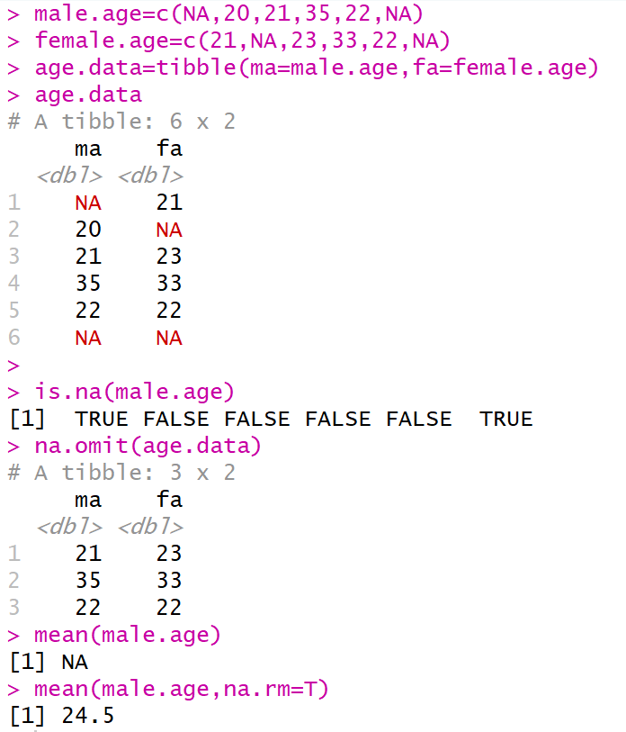
Missing Values

Slide 12
filter()
Used to Subset Observations Based on Their Values
Selects Row if TRUE
Removes Row if FALSE
Examples:
All Flights from 9/13/2018 Out of LaGuardia Airport
All Dec. and Nov. Flights
> filter(flights,month==9,day==13,origin ==“LGA”)
> filter(flights,month==11|month==12)
> filter(flights,month %in% c(11,12))

Slide 13
filter()
Examples:
Don’t Want Flights with Unusual Delays (> 120 min.)
> filter(flights, !(arr_delay>120 | dep_delay>120) )
> filter(flights, arr_delay <= 120, dep_delay <= 120)

Slide 14
Closing?
Disperse and Make Reasonable Decisions

